Slide 1

Coffee Store
REST API
Group 2 Project
Java Masters+ Summer 2026
A Spring Boot REST API for managing coffee products and stock.
Team: Jade Evans, Andrina Nisbet, Ameenah Riffin, Caroline Karanja, Kerene Ndundu
Notes:
We decided to build the backend for an online coffee store. The application provides a REST API for managing coffee products and their stock levels, using Java, Spring Boot and MySQL.

Slide 2

What does our application do?
Group 2 Project
1
2
3
Coffee Products
Stock Management
Database
View products
Add new products
Store product details
Set stock quantities
Increase/decrease stock
Validate stock changes
Products stored in MySQL
Data accessed through Spring Data JPA
Notes:
The API lets a client interact with the coffee catalogue through REST endpoints. Requests come through our controller, the service layer handles the business logic, and the repository communicates with our MySQL database

Slide 3
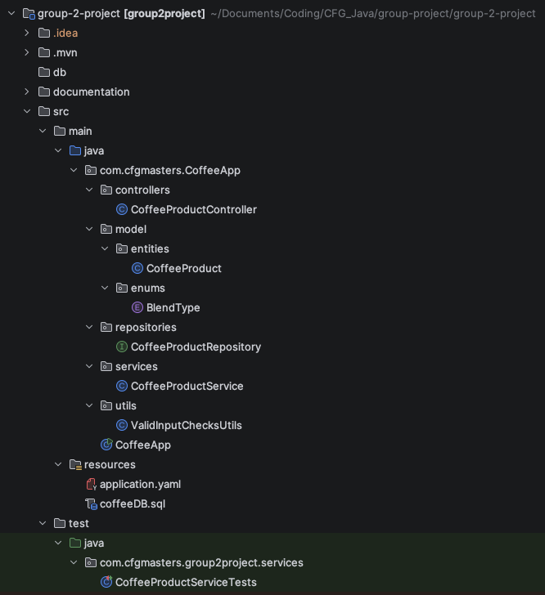
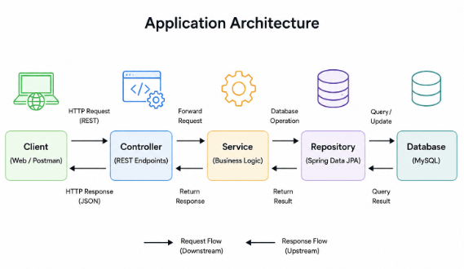
How we built it
Notes:
On the left is our layered architecture, and on the right you can see how we organised the code inside IntelliJ. We separated responsibilities into controllers, services, repositories, models and utilities following common Spring Boot conventions.
Our application follows a layered Spring architecture. HTTP requests are received by the controller, which delegates business logic to the service layer. The service communicates with the repository, which manages persistence in the MySQL database.

Slide 4

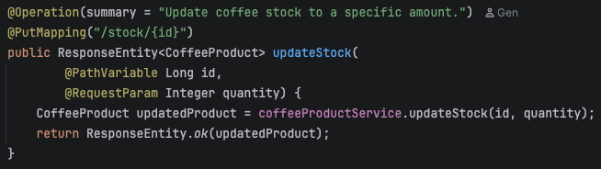
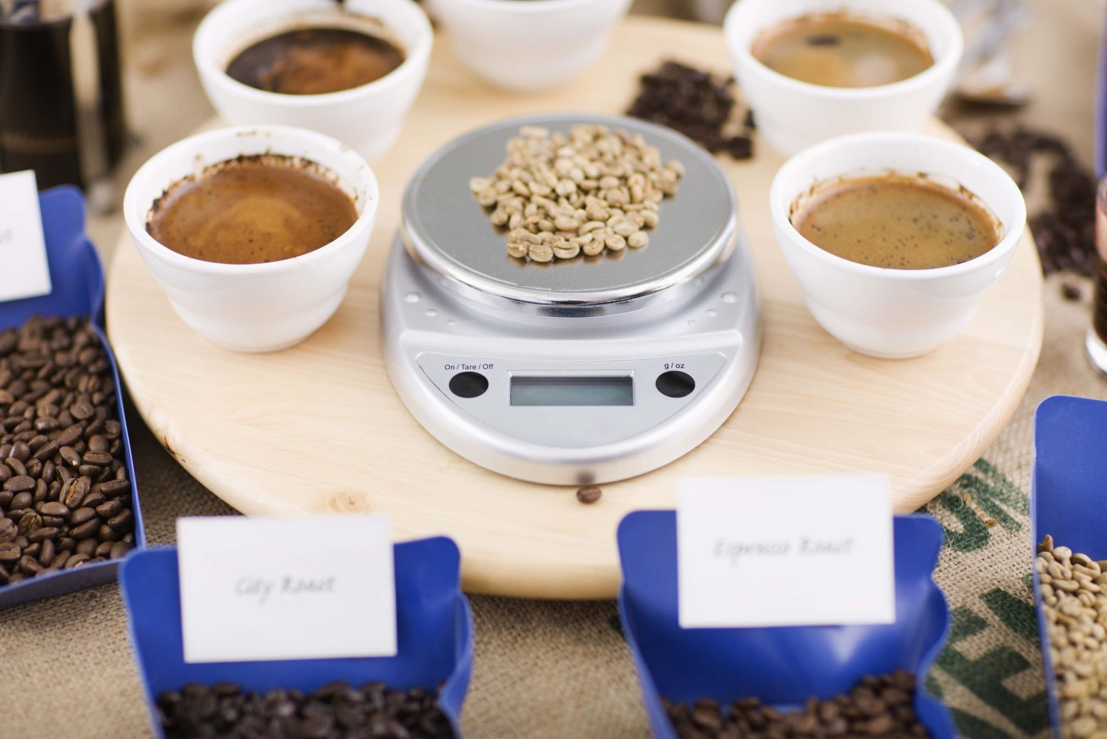
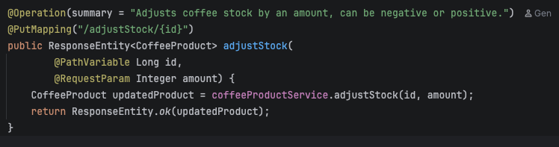

Example: Stock Management
Our API provides two ways to manage product stock
Group 2 Project
Set stock to a specific quantity (20):
PUT /products/stock/1?quantity=20
Sets the products stock to 20
Adjust existing stock:
PUT /products/adjustStock/1?amount=-5
Reduces the existing stock by 5
Notes:
One of the features we've implemented is stock management. We have two PUT endpoints. The first sets a product's stock to a specific quantity, while the second adjusts the existing stock by either a positive or negative amount.
The controller receives the request and passes it to the service, where the business logic is handled. The updated product is then saved through the repository and returned to the client.

Slide 5
Teamwork and Next Steps
Group 2 Project
Collaborative Development
GitHub feature branches
Individual feature development
Merging into the main project
Code Integration
Pull requests & code reviews
Resolving merge conflicts
Integrating team members’ code
1
2
Shared Environment
Docker & MySQL
Consistent local setup
Testing our integrated application
Next Steps
Complete remaining functionality
Finish testing with JUnit and Mockito
Finalise documentation & Open API
Final review before submission
Future Developments
Complete remaining functionality
Finish testing
Finalise documentation & Open API
Final review before submission
3
4
5
Notes:
We've worked collaboratively using GitHub, with each of us developing features on separate branches and using pull requests to merge our work. That's also given us experience resolving merge conflicts and integrating code written by different team members.
As the project isn't due until next week, we're still actively developing it. Our next steps are to finish the remaining functionality, and write automated unit tests with JUnit and Mockito to verify the service logic and validation. We also need to finalise our documentation ready for submission.

